Slide 1


Network Model Protocols and Standards, Internet Standards LAYERED TASKS: Sender, Receiver, and Carrier. THE OSI MODEL: Layered Architecture , Peer-to-Peer Processes, Encapsulation
Lecture # 7 and 8
Week# 4
Data Communications and Networking, Fourth Edition, Behrouz A. Forouzan

Slide 2
Protocol
Protocols and Standards
What is a Protocol?
A protocol is a set of rules that computers follow to communicate with each other.
Protocol = Language of computers
Example
Just like humans use English or Urdu to talk, computers use protocols like:
HTTP
TCP
IP
Without protocols, computers cannot understand each other.

Slide 3
Standards
What are Standards?
Standards are official rules that ensure:
Devices from different companies work together
Communication is reliable and correct
Example
Laptop (HP) communicating with server (Dell)
Mobile phone connecting to Wi-Fi router
This works because everyone follows the same standards.
Easy Analogy
Traffic rules:
Red = Stop
Green = Go Everyone follows the same rules → no accidents

Slide 4
Internet Standards
What are Internet Standards?
Internet standards are rules specifically made for the Internet.
They define:
How data is sent
How websites work
How emails are delivered
Examples of Internet Standards
HTTP → Web browsing
FTP → File transfer
SMTP → Email sending
IP → Addressing
Simple Example
When you open google.com, it works because:
Browser
Server Both follow Internet standards

Slide 5
Layered Tasks: Sender, Receiver, and Carrier
Communication is divided into layers, and each layer has a specific job.
Sender
Prepares data
Breaks data into packets
Adds address information
Example: You send a WhatsApp message.
Carrier
Carries data through the network
Uses cables, Wi-Fi, fiber, etc.
Example: Internet cables and Wi-Fi signals
Receiver
Receives data
Reassembles packets
Shows message to user
Example: Your friend receives and reads the message.

Slide 6
Layered Architecture
Layered Architecture (OSI Model Concept)
What is Layered Architecture?
Layered architecture means:
Each layer performs one specific function
Layers work independently
Example
If internet is slow:
Physical layer → cable issue
Network layer → IP problem

Slide 7
The OSI Model
The OSI Model is a 7-layer reference model that explains how data moves from sender to receiver.
OSI = Open Systems Interconnection
Why OSI Model?
Makes networking easy to understand
Divides complex communication into steps

Slide 8
7 Layers of OSI
Layer | Purpose
7. Application | User interaction (Browser, Email)
6. Presentation | Format & encryption
5. Session | Session management
4. Transport | Reliable delivery (TCP/UDP)
3. Network | Routing & IP addressing
2. Data Link | MAC address & framing
1. Physical | Cables, signals

Slide 9
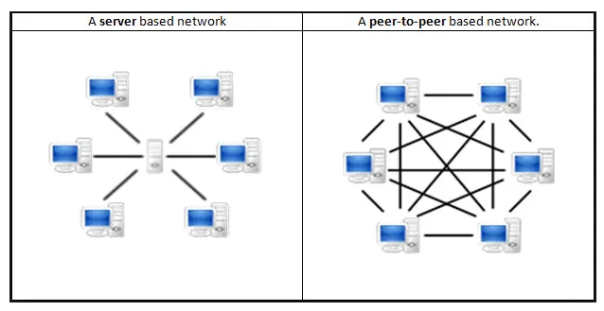
Peer-to-Peer Processes
What is Peer-to-Peer (P2P)?
In Peer-to-Peer, both devices act as sender and receiver.
No central server needed.
Examples
File sharing apps
Bluetooth file transfer
Torrent download
Easy Example
Two friends:
Both can talk
Both can listen No boss in between

Slide 10
Encapsulation
What is Encapsulation?
Encapsulation means wrapping data with extra information as it moves from the sender to the receiver.
Encapsulation = Packing data layer by layer before sending
When you send a message or data:
Step 1: Application Layer
Creates the actual message
Example: “Hello”
Step 2: Transport Layer
Adds port number
Helps deliver to correct app
Step 3: Network Layer
Adds IP address
Finds the path
Step 4: Data Link Layer
Adds MAC address
Helps deliver in local network
Step 5: Physical Layer
Converts data into signals
Sends through cable or Wi-Fi
Like courier carrying the box

Slide 11
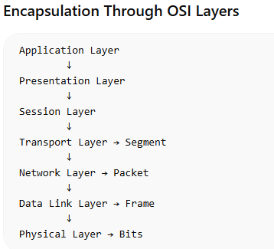
Encapsulation
WhatsApp Example
You send “Hi” on WhatsApp:
Message created
Port added (WhatsApp app)
IP added (friend’s phone)
MAC added (local delivery)
Data sent as signals
This full wrapping = Encapsulation

Slide 12
Encapsulation Flow
Segment (Transport Layer)
At the Transport Layer, data is divided into small parts called segments.
This helps send data reliably and in order.
Example: You send a large file by email. The system breaks the file into smaller segments so it can be transmitted easily.
Packet (Network Layer)
At the Network Layer, the segment becomes a packet.
The packet contains the IP address of sender and receiver so the data can find the correct path across networks.
Example: When you open a website, packets travel through routers on the internet using IP addresses

Slide 13
Encapsulation Flow
Frame (Data Link Layer)
At the Data Link Layer, the packet becomes a frame.
The frame contains MAC addresses of the sender and receiver devices.
Example: Inside a Wi-Fi or LAN network, the router uses MAC addresses to send the frame to the correct computer.
Bits (Physical Layer)
At the Physical Layer, the frame is converted into bits (0s and 1s).
These bits travel through network cables, fiber optics, or wireless signals.
Example: In an Ethernet cable, data moves as electrical signals representing 0 and 1.

Slide 14
THANK YOU
You can Find me:
mehakrana.CS@tuf.edu.pk

